Slide 1
3D Image Segmentation and Quantification of Lysosomes
Comparison manual.VS. automatic
4/12/2025

Slide 2
LAST MEETING
My progress these last few weeks:
Checked the size.
Included additional metrics such as mean and standard deviation.
Comparison MANUAL.vs.AUTOMATIC.
Now the script can assign serial order numbers to lysosome and cell IDs.
Review possible over-detection in some images.
I am working in the automatization of same parameters to avoid or reduce over deteccion on all images.
Verify cases where there are lysosomes outside with a different cell ID.
I will start working on this point next week.
OREN: One addition/clarification - need to find a way to limit cell size to a certain (lower) limit so to exclude these fragments being counted as a cell…

Slide 3
FILES
40A_UAS-TMEM1923x-HA x 71G10 40A MARCM_L3_1_Airy_010724
Airy scan_40A_UAS-TMEM-HA_CB_0h_1_051222
Airy scan_40A_UAS-TMEM-HA_CB_0h_2_051222
Airy scan_40A_UAS-TMEM-HA_CB_4h_1_051222
Airy scan_40A_UAS-TMEM-HA_CB_4h_2_051222
TMEM-HA 6h CB airy_3_170722
40A_UAS-TMEM192-3xHA x 40A 71G10 MARCM_around 12h - for quantification_4 Airy-CBs_300425
40A_UAS-TMEM192-3xHA x 40A 71G10 MARCM_around 12h - for quantification_3 Airy-CBs_300425

Slide 4
40A_UAS-TMEM1923x-HA x 71G10 40A MARCM_L3_1_Airy_010724

Slide 5
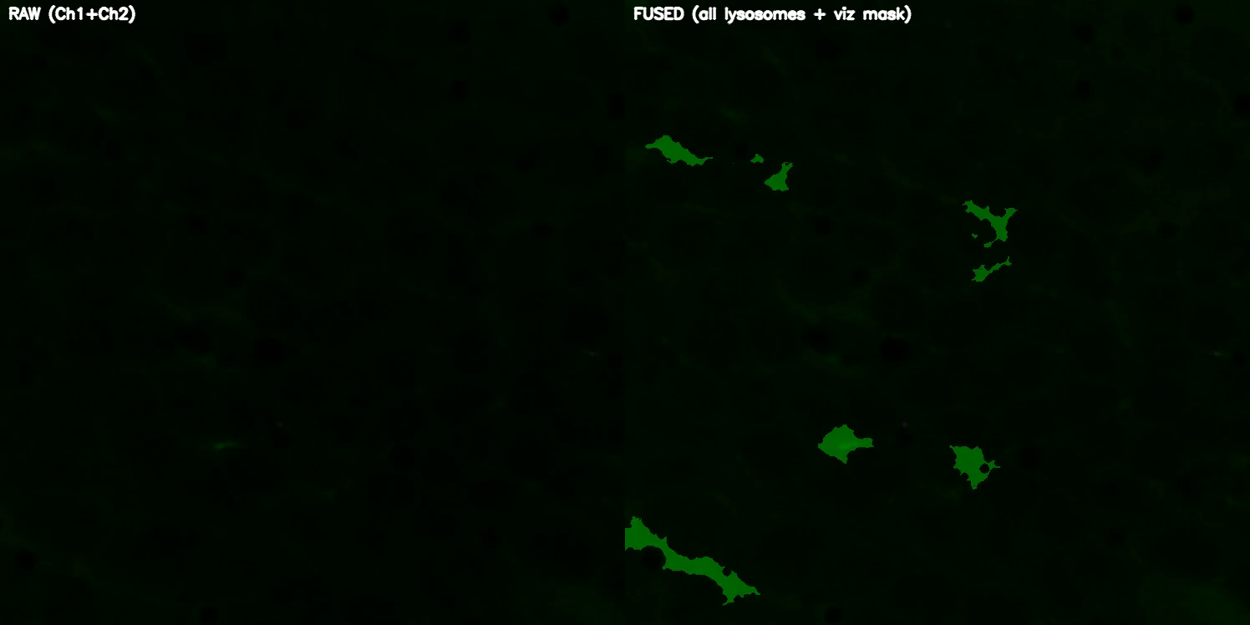
DETECTION VIDEO

Slide 6
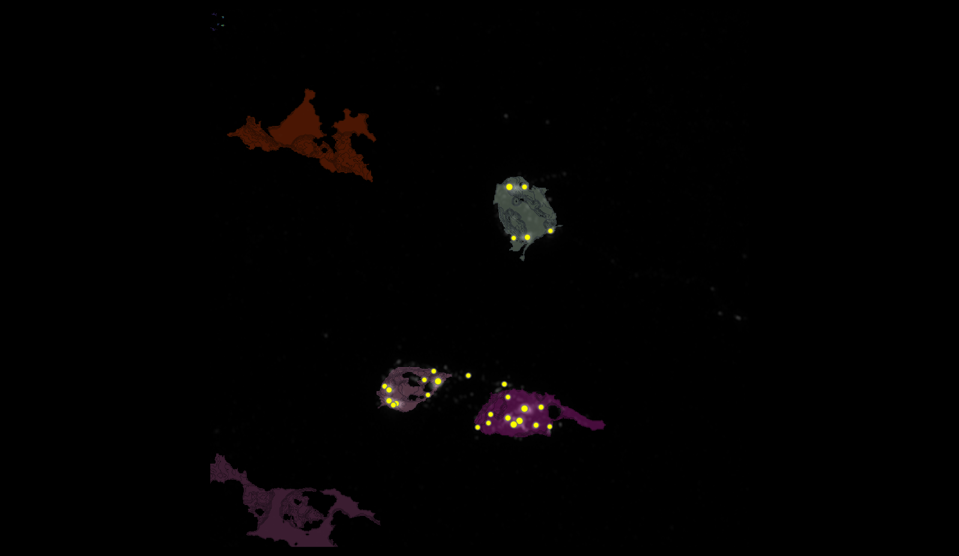
SEGMENTATION
2
3
4

Slide 7
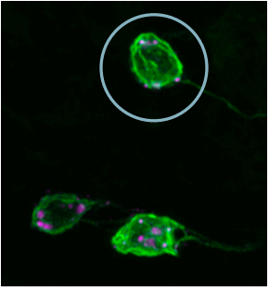
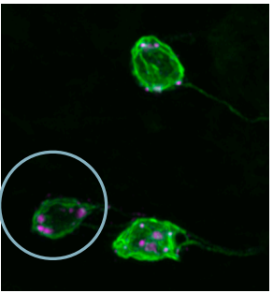
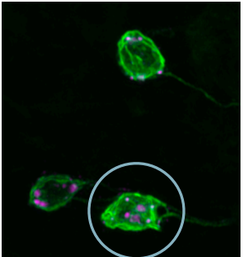
MANUAL.vs.AUTOMATIC
2
3
4

Slide 8
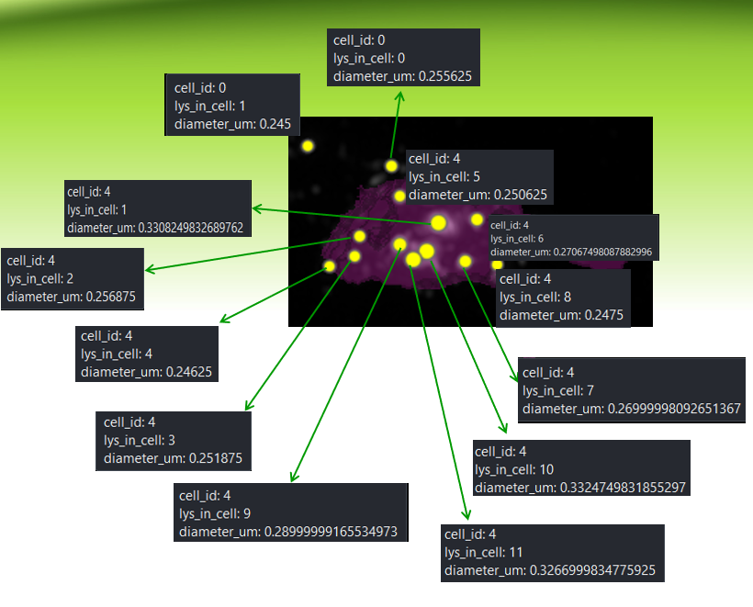
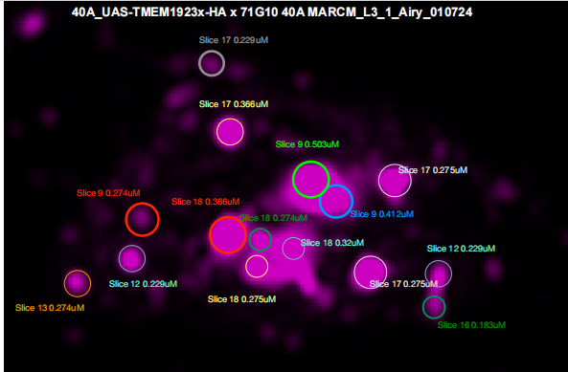
MANUAL.vs.AUTOMATIC
4
1
0
6
5
1
2
4
9
10
8
3
7
11
OUTSIDE
INSIDE

Slide 9
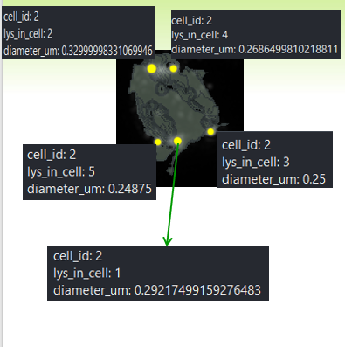
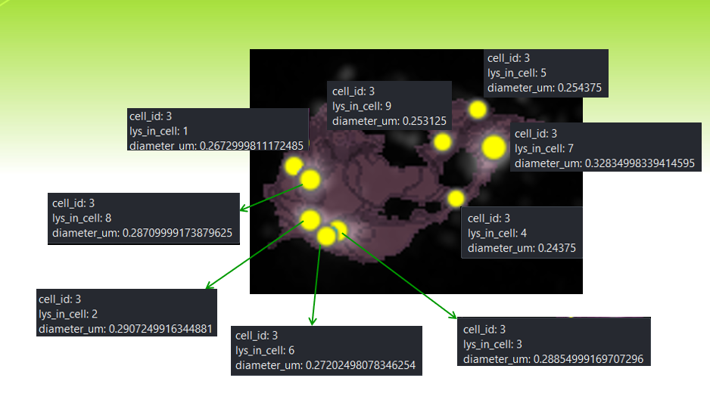
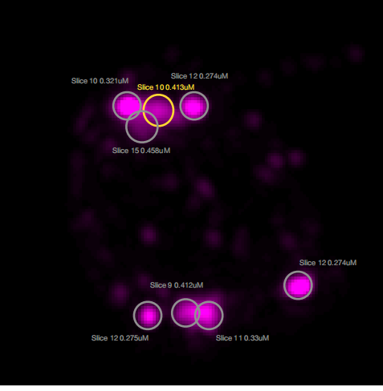
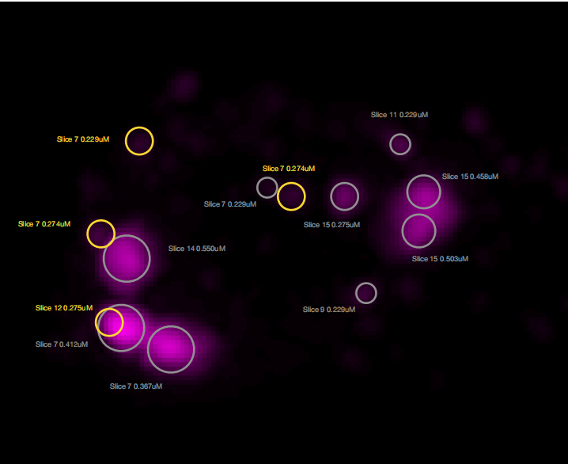
DATASET LYSOSOMES(ORDER FOR CELL ID)
3
2
2
4
5
9
1
7
2
8
3
4
5
6
3
1

Slide 10
Airy scan_40A_UAS-TMEM-HA_CB_0h_1_051222

Slide 11
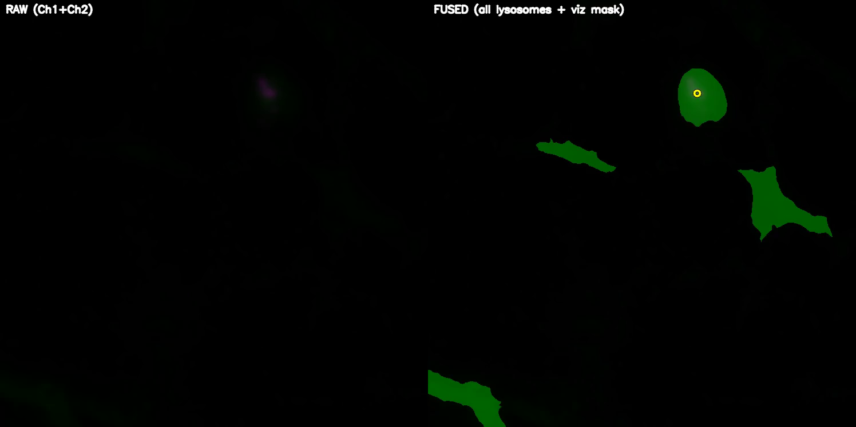
DETECTION VIDEO

Slide 12
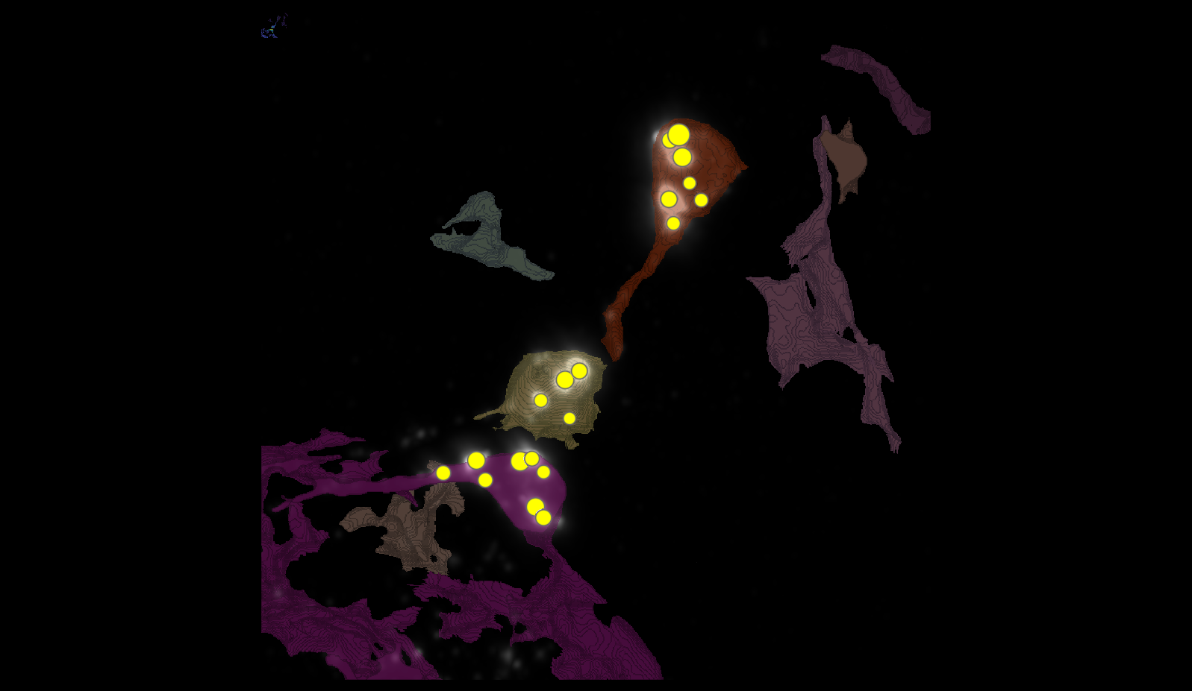
SEGMENTATION

Slide 13
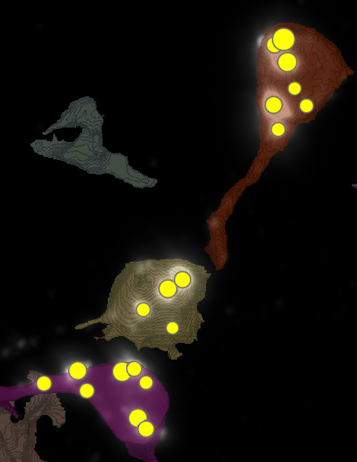
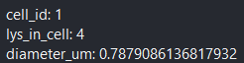
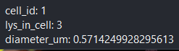
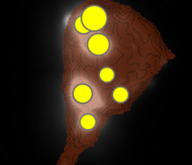
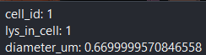
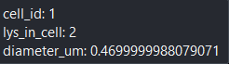
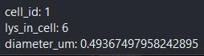
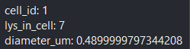
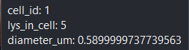
METRICS
1
6
4

Slide 14
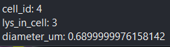
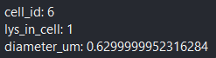
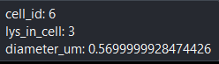

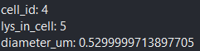
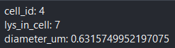

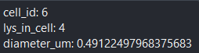
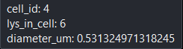
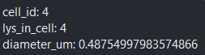
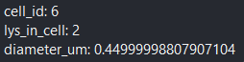
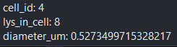
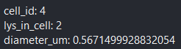
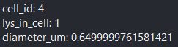
METRICS

Slide 15
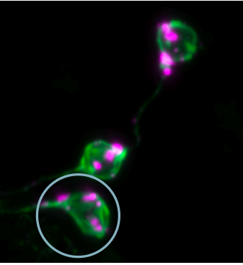
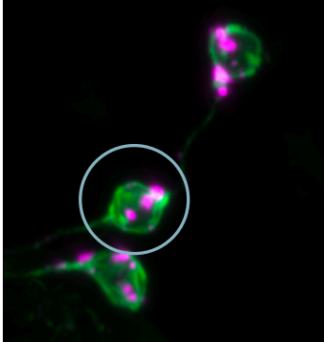
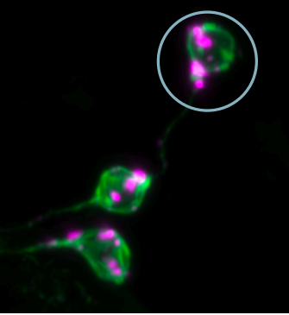
MANUAL.vs.AUTOMATIC

Slide 16
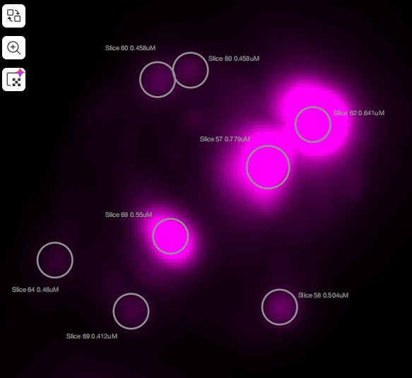
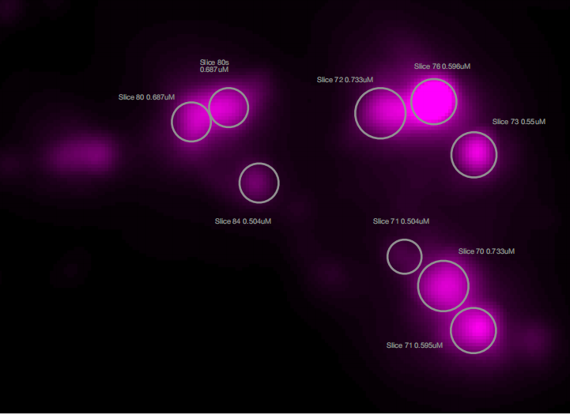
MANUAL.vs.AUTOMATIC
3
7
3
5
1
4
8
4
2
1
2

Slide 17
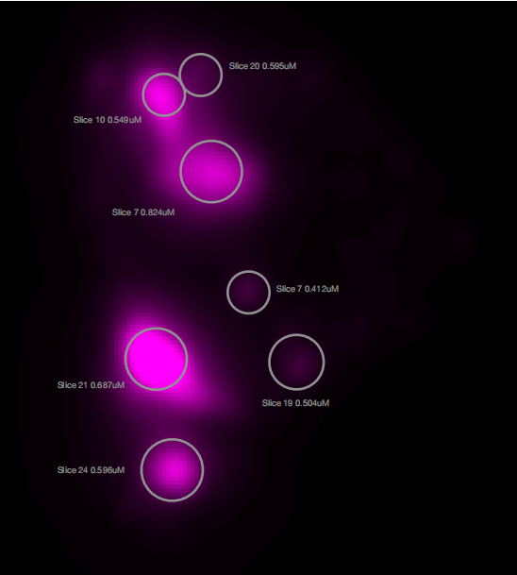
MANUAL.vs.AUTOMATIC
4
3
1
2
5
6
7

Slide 18
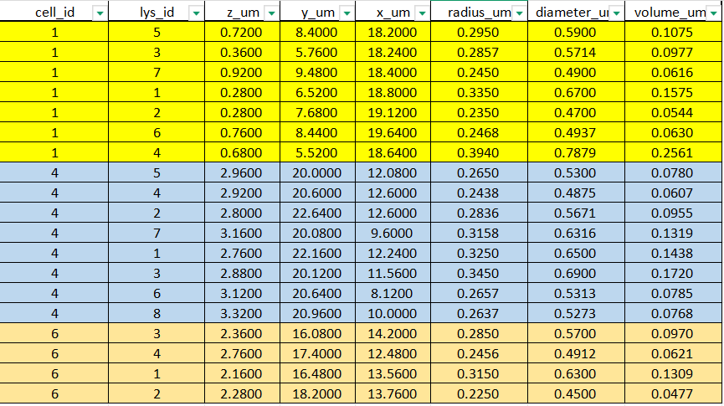
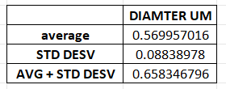
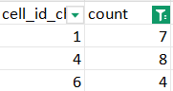
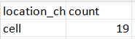
DATASETS

Slide 19
TMEM-HA 6h CB airy_3_170722

Slide 20
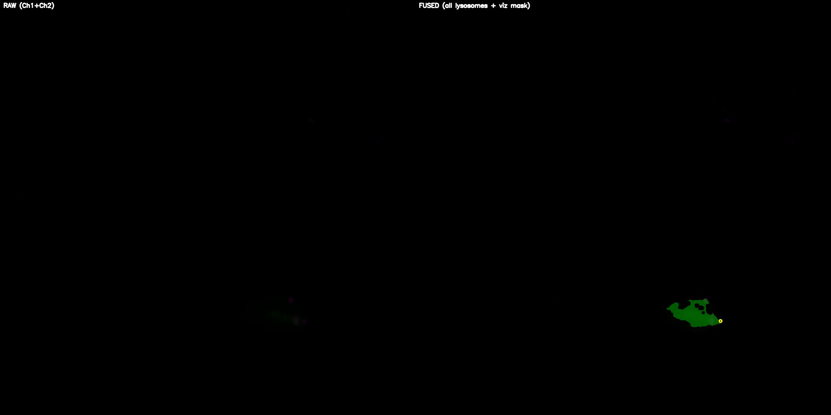
DETECTION VIDEO

Slide 21
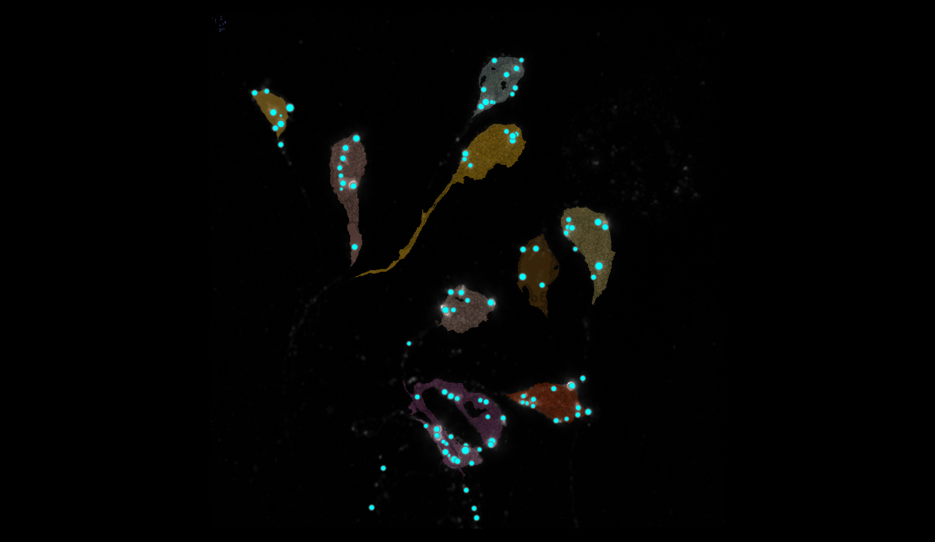
SEGMENTATION
24
2
9
8
6
7
15
1
3
5

Slide 22
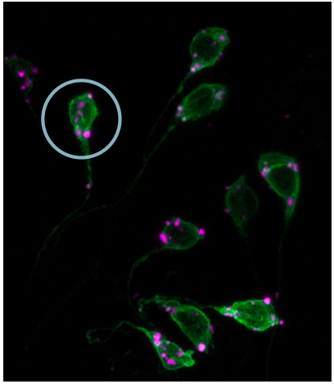
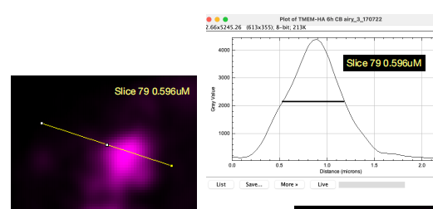
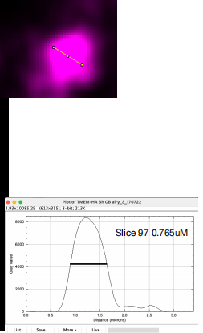
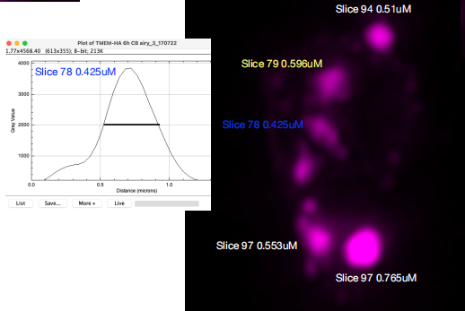

MANUAL.vs.AUTOMATIC

Slide 23

MANUAL.vs.AUTOMATIC

Slide 24





DATASET LYSOSOMES(ORDER FOR CELL ID)

Slide 25
40A_UAS-TMEM192-3xHA x 40A 71G10 MARCM_around 12h - for quantification_4 Airy-CBs_300425

Slide 26

DETECTION VIDEO

Slide 27

SEGMENTATION

Slide 28



MANUAL.vs.AUTOMATIC + DATASET LYSOSOMES
1 CELL, 3 LYSOSOMES
N CELL | ID LYSOSOMES | MANUAL DIAMETER UM | AUTOMATIC DIAMETER UM
3 | 1 | 0.504 | 0.45
3 | 2 | 0.412 | 0.39
3 | 3 | 0.366 | 0.391

Slide 29
40A_UAS-TMEM192-3xHA x 40A 71G10 MARCM_around 12h - for quantification_3 Airy-CBs_300425

Slide 30

DETECTION VIDEO

Slide 31

SEGMENTATION
2
18
35
39
38
65

Slide 32



MANUAL.vs.AUTOMATIC

Slide 33

MANUAL.vs.AUTOMATIC

Slide 34




DATASET LYSOSOMES(ORDER FOR CELL ID)

Slide 35

DATA ALL IMAGES
I used the image of 12H 4 and excluded that of 12H 3 because it only has one cell and 3 lysosomes, whereas 12H 4 has more cells and lysosomes, so it seemed more representative for the graph.

